Slide 1
Self analysis

Slide 2
Learning Outcomes
At the end of this session you will be able to:
identify and articulate your own skills, strengths, and areas for improvement.
develop awareness of your unique abilities and talents that can contribute to your personal and professional success.

Slide 3
Uncover your strengths, Potential & blockers
Strengths
Weaknesses
Opportunities
Threats

Slide 4


strengths
Ask yourself questions:
What are you good at naturally?
What skills have you worked to develop?
What are your talents?
How strong is your network of connections?
What do other people see as your strengths?
What sets you apart from the others? (values/ethics etc)

Slide 5



Weaknesses
What are your negative work habits and traits?
Where can you improve?
What are you afraid to do or avoid doing?
What do others see as your weaknesses?

Slide 6
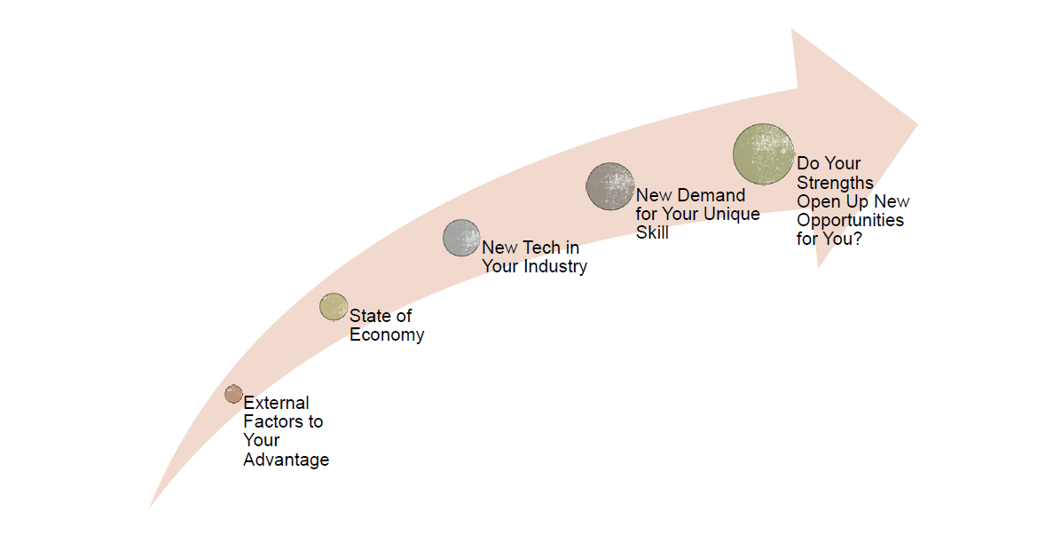
Opportunities
Is there a need in the industry no one is filling?
Growth in the industry?
Networking events, conferences, educational courses?

Slide 7

threats
Is your industry contracting?
Is the economy affecting recruitments?
Strong competition for your jobs?
External danger to your growth?
New standards you can’t/have not been able to meet?
New technology/certification requirements you need to fulfill ?

Slide 8
Group activity – 15 mins
Pair up with your friend and perform a SWOT analysis, by helping each other identify strengths and weaknesses

Slide 9

What next?

Slide 10

Match or Convert
Match strengths to opportunities to be aggressive and take action
Strength is networks, reach out to them to seek training opportunities
Match weaknesses to threats and identify areas you should work on or avoid
Convert by turning negatives to positives
Convert weaknesses to strengths and threats to opportunities
E.g Use strength of independent learning to upskill and get certifications

Slide 11

Perform a swot analysis on yourself & bring it to the next class

